Slide 1


CUSTOMER CHURN PREDICTION
CAPSTONE PROJECT
EduBridge Project
BANK CUSTOMER CHURN PREDICTION
Presented By DABatch(8934) :
Priyanka Sharma

Slide 2
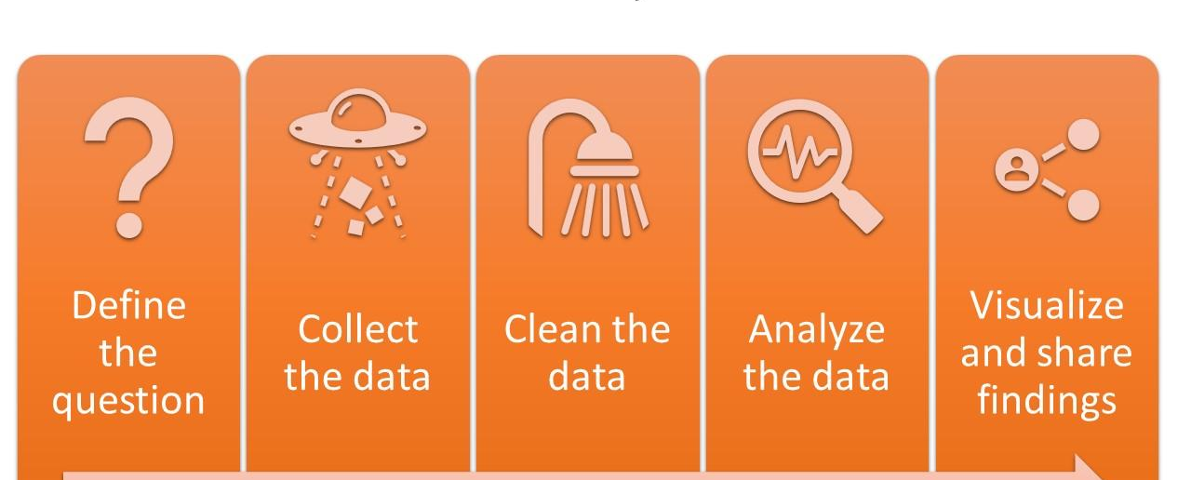
DATA ANALYSIS PROCESS FLOWCHART

Slide 3
PROBLEM STATEMENT
“A Manager in Bank is disturbed with more and more customers leaving their credit card services.
Our task is to predict the customers who is gonna get churned so that they can proactively go to customer to retain them back and can serve their customer efficiently and provide them better services.”

Slide 4
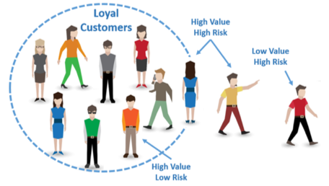
INTRODUCTION
What is Customer Churning?
Customer churn is the percentage of customers that stopped using your company's product or service during a certain time frame. It is measure of how many of your customers are leaving your business.

Slide 5
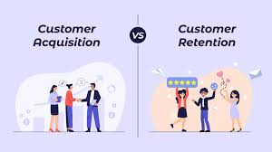
Why Is Customer Churn Rate Important?
It's important because it costs more to acquire new customers than it does to retain existing customers. In fact, an increase in customer retention of just 5% can create at least a 25% increase in profit. This is because returning customers will likely spend 67% more on your company's products and services.

Slide 6
DATA SET EXPLORATION
CLIENTNUM | Client number. Unique identifier for the customer holding the account
Attrition_Flag | Internal event (customer activity) variable - if the account is closed then 1 else 0
Customer_Age | Demographic variable - Customer's Age in Years
Gender | Demographic variable - M=Male, F=Female
Dependent_count | Demographic variable - Number of dependents
Education_Level | Demographic variable - Educational Qualification of the account holder (example: high school, college graduate, etc.)
Marital_Status | Demographic variable - Married, Single, Divorced, Unknown
Income_Category | Demographic variable - Annual Income Category of the account holder (< $40K, $40K - 60K, $60K - $80K, $80K-$120K, >
Card_Category | Product Variable - Type of Card (Blue, Silver, Gold, Platinum)
Months_on_book | Period of relationship with bank
Total_Relationship_count | Total no. of products held by the customer
Months_Inactive_12_mon | No. of months inactive in the last 12 months
Contacts_Count_12_mon | No. of Contacts in the last 12 months
Credit_Limit | Credit Limit on the Credit Card
Total_Revolving_Bal | Total Revolving Balance on the Credit Card
Avg_Open_To_Buy | Open to Buy Credit Line (Average of last 12 months)
Total_Amt_Chng_Q4_Q1 | Change in Transaction Amount (Q4 over Q1)
Total_Trans_Amt | Total Transaction Amount (Last 12 months)
Total_Trans_Ct | Total Transaction Count (Last 12 months)
Total_Ct_Chng_Q4_Q1 | Change in Transaction Count (Q4 over Q1)
Avg_Utilization_Ratio | Average Card Utilization Ratio
This data set consists of 10,000 customer details(rows) distributed among 21 features(columns).we have only 16.07% of customers who have churned

Slide 7
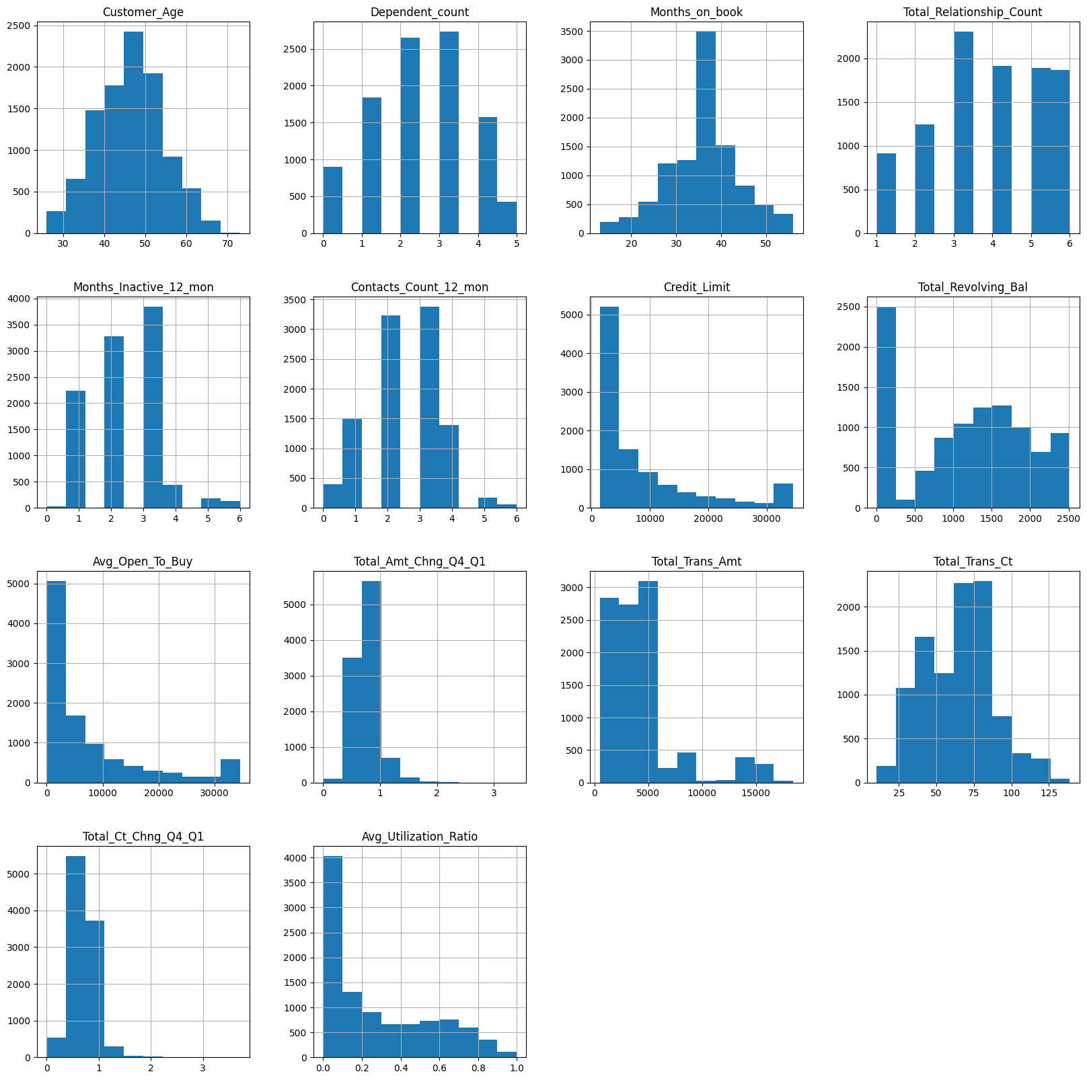
EXPLORATORY DATA ANALYSIS(EDA)
EDA using histograms to check the distribution of given discrete data .It has helped us in predicting-
1.Distribution of discrete data
2.Frequency of the given data
3.To check Dominance of various factor available in data set.
We came to know about certain unknown category in few columns in our data set using the same plots.
Apart from this detail study data can give usefull insights to sales department .

Slide 8
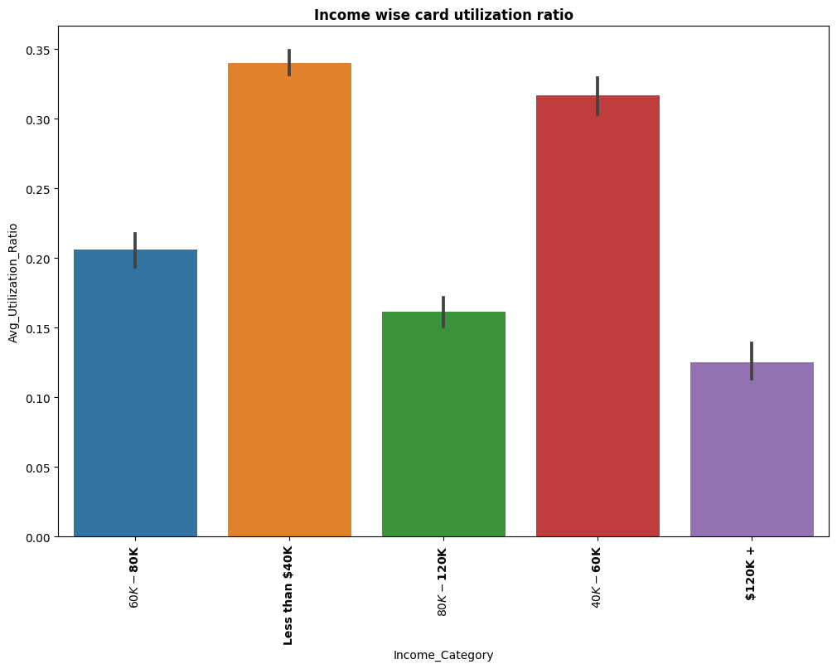
EDA-Income-Expenditure Analysis
As we can clearly see from the graph that customers are
Divided in to following four category-
1.Low income High expenditure
2.Low income Low expenditure
3.High income High expenditure
4.Low income High expenditure
Dominance of one group shows that Customers with Low income High expenditure are target customer for credit cards.

Slide 9
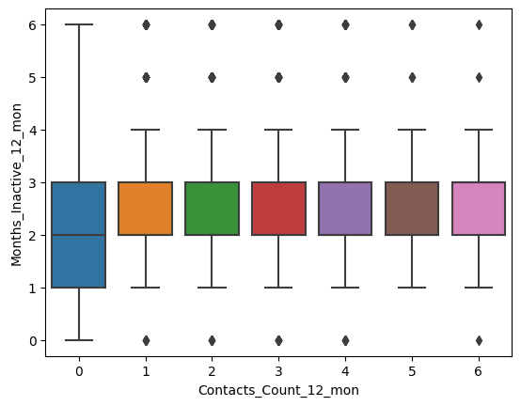
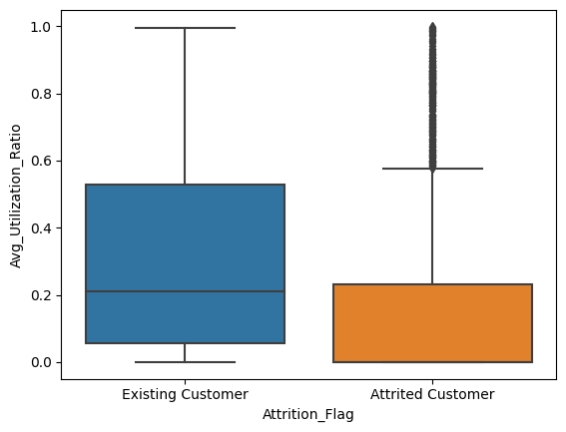
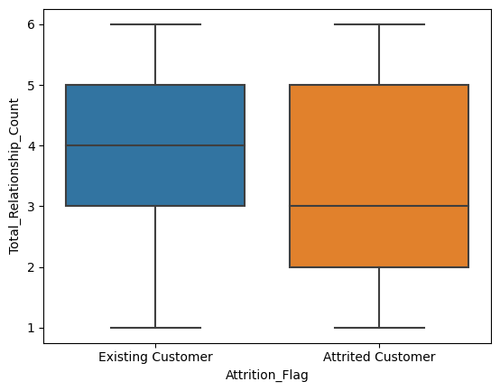
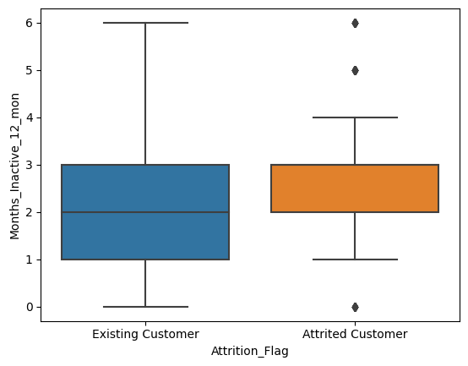
EXPLORATORY DATA ANALYSIS(EDA)
EDA using boxplot has helped in understanding consumer behaviour with respect to our target data
Inferences-
We came to know about following insights
Attrited customers usage is very less They are leaving us in initial phase (2-3 months)after availing Ccservices
Attrited customers follow due cycle(dormancy) of only one month.
Customer contact detail insights

Slide 10
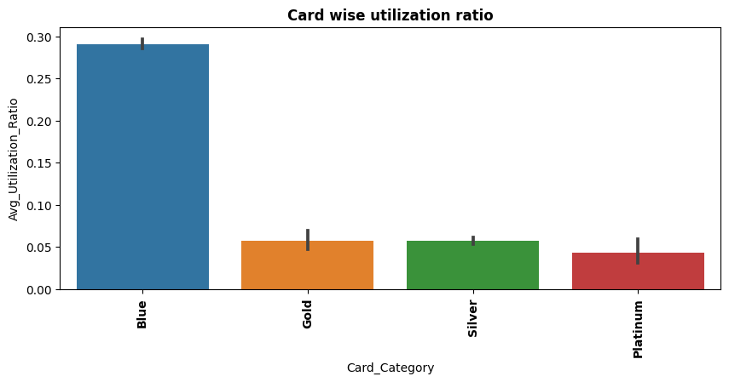
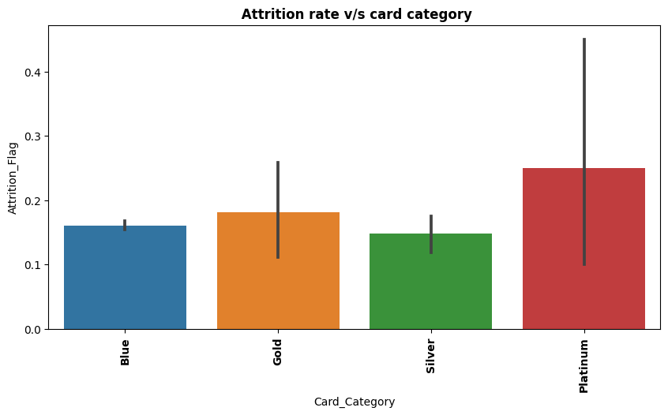
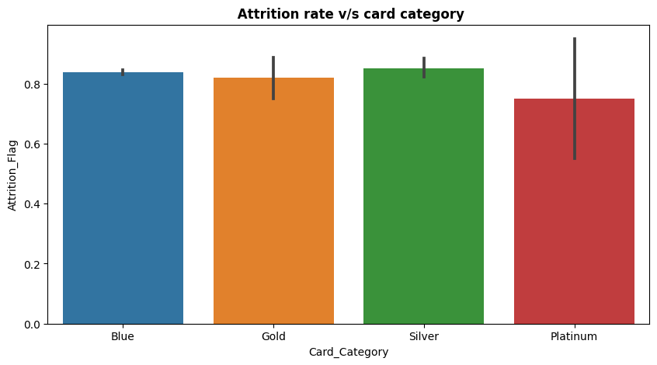
EXPLORATORY DATA ANALYSIS(EDA)
EDA using bar plot has helped in understanding consumer behaviour with respect to our target data
Inferences-
Blue card category dominates in term of card usage.
Platinum and Gold category customers are the High value customer whose transaction amount is large.
Attrition is not specific to any single category of card.

Slide 11
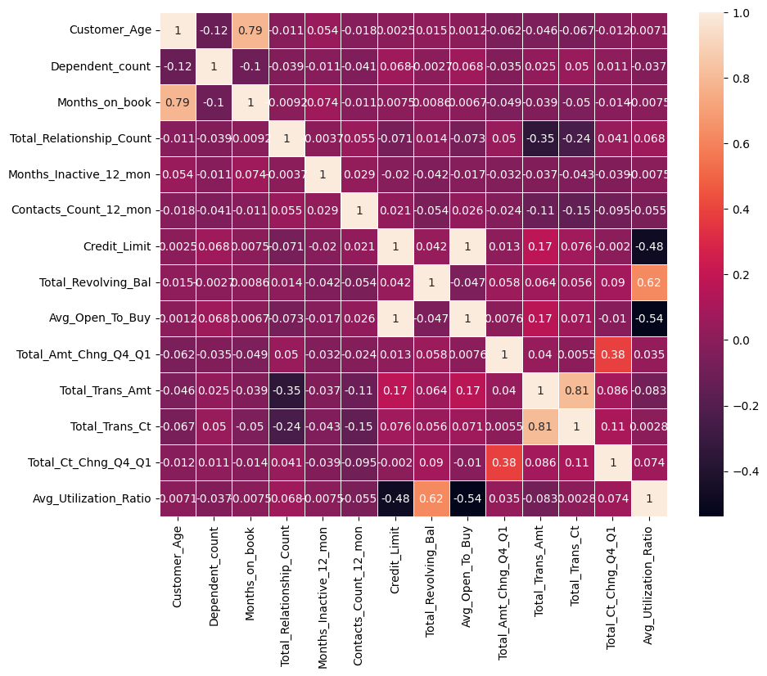
EDA-Heatmap Analysis
If the value is 1, it is said to be a positive correlation between two variables. This means that when one variable increases, the other variable also increases.
If the value is -1, it is said to be a negative correlation between the two variables. This means that when one variable increases, the other variable decreases.
If the value is 0, there is no correlation between the two variables. This means that the variables changes in a random manner with respect to each other.

Slide 12
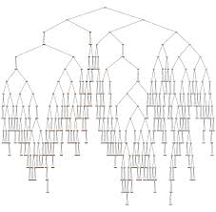
MODEL SELECTION
Here we have used following Machine Learning Algorithm
RANDOM FOREST TREE
Random forest Tree is used to predict value of our target variable commonly known as Dependent Variable on the basis of the many features available known as independent variable

Slide 13
INFERENCE
Following insights can be drawn from EDA-
TARGET CUSTOMER-As per the data set our major target customers for credit card services are customers with low income and high expenditure.
CUSTOMER SERVICE DEPARTMENT-Service department required to be active after selling CC atleast for initial two month rigorous follow up is required as most of the customers are leaving during initial phase only .
BEHAVIOUR ANALYSIS OF CUSTOMER-Behaviorial pattern of attrited customers shows that they usually do not show overdue for more than one month .they are taking decisions proactively. Attrition is not specific to any particular card category .all most all types of card segment is facing attrition

Slide 14
Thank You

